Slide 1
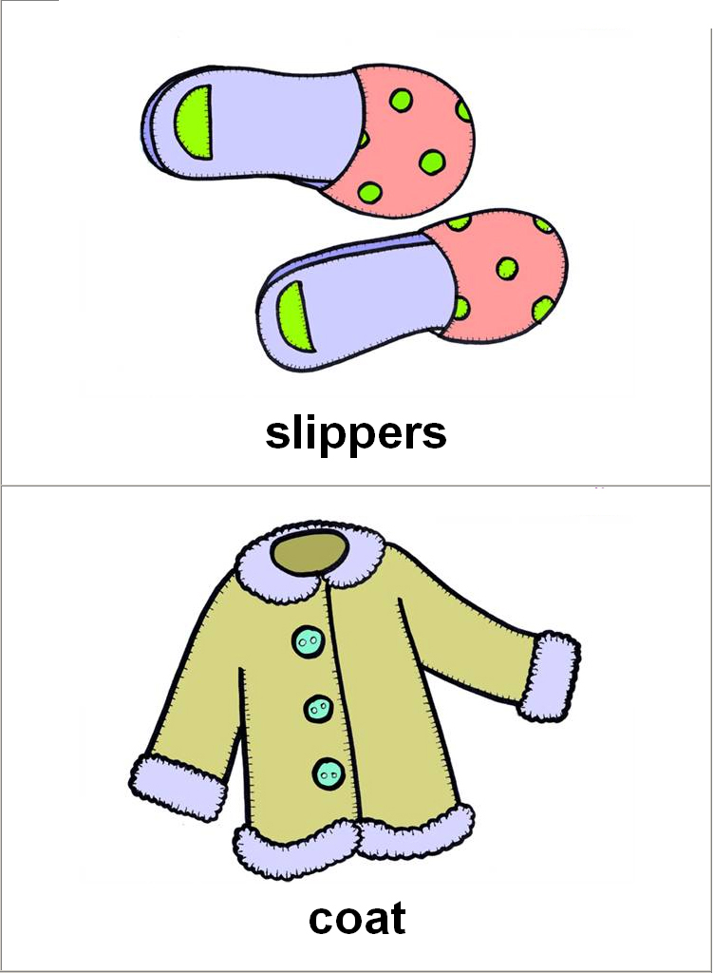
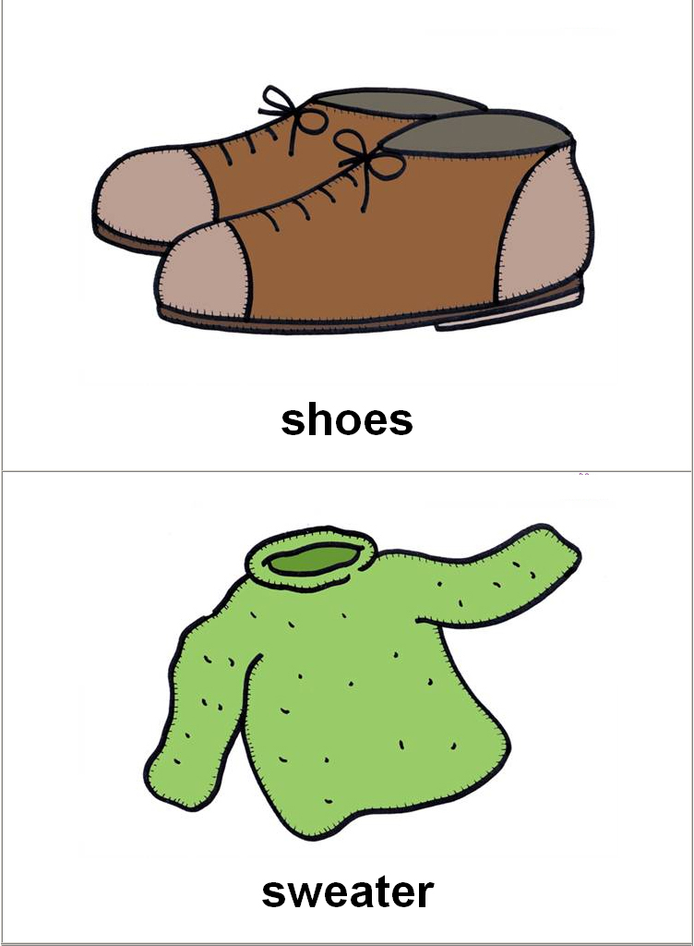
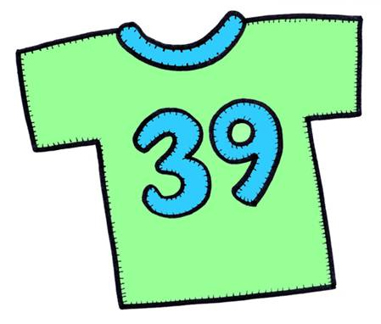


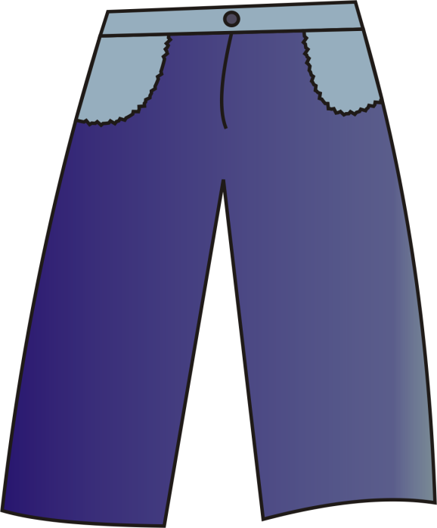
IT’S A T-SHIRT.
Good Job!
NEXT

Slide 2
THEY ARE TROUSERS.
Good Job!
NEXT

Slide 3
IT’S A COAT.
Good Job!
NEXT

Slide 4
THEY ARE SHOES.
Good Job!
NEXT

Slide 5
IT’S A JUMPER.
Good Job!
NEXT

Slide 6
IT’S A HAT.
Good Job!
NEXT

Slide 7
IT’S A T-SHIRT.
Good Job!
NEXT

Slide 8
THEY ARE TROUSERS.
Good Job!
NEXT

Slide 9
IT’S A DRESS.
Good Job!
NEXT

Slide 10
THEY ARE SHOES.
Good Job!
NEXT

Slide 11
IT’S A HAT.
Good Job!
NEXT

Slide 12
GOOD JOB!

